Slide 1
Welcome

Slide 2

Year 2022-23
Presentation of
Internship

Slide 3
Content :
Introduction
Requirement Analysis
Software system Attributes
System Design
Graphical User Interface
Conclusion
Bibliographies

Slide 4
Introduction :
1.1 Organization Overview
AIS Solutions Pvt. Ltd. in Kothrud, Pune is a reliable name in the industry as they aim to deliver the best experience to their customers. This has helped them build up a loyal customer base. They started their journey in 2018 and ever since, they have ensured that the customer remains at the centre of their business operations and philosophy. As they are located in a favorable neighbourhood , exactly at Office No 305, 3rd Floor, Pandurang Apartment, Nr City Hospital, Opp Kachara Depot, Paud Road, Kothrud-411038 near Nr City Hospital, Opp Kachara Depot, it is easy to locate AIS Solutions Pvt. Ltd. on the map.
For any kind of assistance or questions, it is best to contact them directly during their business hours . Products or Services offered : Also listed in Computer Training Institutes ,Tutorials , Tutorials For Share Trading, Share Brokers, Education Consultants etc. AIS Solutions Pvt. Ltd. in Kothrud is one of the most trustworthy names in the field. They have received a 4.8 rating from their customers.

Slide 5
1.2 Project Overview
So as project we have been given tasks to perform .The task tends to completing of a website.The website is related to restaurant management system and Digital mall System.So it was upto us what we want to design but design and development methodology was same.
So tasks are as follows-
Task 1:
The first assignment consist of setuping and install mySql database.We have studied about types of database,redundacy ,what is tuple and study of student course database system.
MySQL creates a database for storing and manipulating data, defining the relationship of each table. Clients can make requests by typing specific SQL statements on MySQL. The server application will respond with the requested information and it will appear on the clients' side.

Slide 6
Task 2:
In the second assignment we have studied about users of database and interfaces they need we have drawn and implemented dbms architecture for airline reservation system .So in this we have used three tier client-server architecture.Three-Tier Client/Server Architecture for Web Application is the best choice. The Client consists of Web User Interface. The Web Server contains the application logic which includes all the rules and regulations related to the reservation process and the issue of tickets; the Database Server contains the DBMS.
In this section we have studied about constraints in database to study this we have studied example of student course database.
Along with that we have studied dtabase schema and database state.When we define a new database, we specify its database schema only to the DBMS. At this point, the corresponding database state is the empty state with no data

Slide 7
Task 3:
This task was about basic of web development.That is it deals with creating a new folder for website files .The rules were :
There should not be any spaces.
Using Notepad++, we will be creating a HTML file called “index.html” and then a CSS file called “stylerules.css”. Then we named it as your index.html file will look something like this when
displayed in a browser
Basic html code –
<!DOCTYPE html>
<html>
<head>
<title>add your page title here</title>
<link rel="stylesheet" type="text/css" href="stylerules.css">
<meta charset="utf-8">
<1-Add your three meta tags below this comment line-->
</head>
<body>
The top of the body element
.<div id="container" class="centertext"> <header>This is the header element.</header> <div id="main">This is the div element with ID-main.</div><nav>This is the header element.</nav> <div id="left">This is the div element with ID=left,</div>
<footer>This is the footer element </footer>
</div>The bottom of the body element. </body>
</html>

Slide 8
Task 4:
Basic css code-
header { background-color: red; }
nav { background-color: blue; }
#container {
max-width: 960px; margin: 0 auto; background-color: yellow;
#left {float: left; width: 20%; background-color: green;
#main {float: right; width: 80%; background-color: lime;
footer (clear: both;background-color: fuchsia;
.centertext {
text-align: center;
}

Slide 9
Task 5:
We have created a text-based menu in the footer: In the element of index.html file, we have added a text-based menu bar that has a link to each one of web pages in site.
Here is an example of what text-based menu might look like:
HOME | ABOUT US | OUR MENU | MAKE RESERVATIONS | CONTACT US
1.We have made each menu-item a link to the appropriate page/HTML file: HOME Note: If there are spaces in the file name of page (i.e., Contact Us.html), we have made sure to put quotation marks around the file name. Failure to do this will result in page failing to load and browser will display a page not found error. We have copied the menu to the element of each HTML page.
2. Added one external link: On any one page, we have added at least one link to an external web page/site.
3. We have added five images: we have created a new folder inside web site home folder. Named it as assets.
4.To display the images in your pages, add links to each of these five images on any HTML
page(s) that you choose. Tip: If you want text to wrap around an image, you will need to
position the <img> element inside of a <p> element and then add an inline style rule to
the <img> tag that assigns a value to the “float” property like this:
<img src="assets\myMug.jpg" alt="me" style="float:left" >

Slide 10
Task 6:
In this assignment, we have created two tables. One will be assigned an ID and the other will be assigned to a CLASS. We have styled the tables differently. One will use ID-based style rules and the other will use CLASS-based style rules. The table that is assigned to a CLASS will resemble a button-based menu. We have copied this table into each of web pages, in their <nav> element (for “navigation”) so that all pages will have the same menu in the same place to give pages a uniform appearance.
1. We have created one table element on one of web pages.
• table should have at least two columns and two rows
• Some ideas for a table: a price list, a list of locations, a grid of photos
• Assign a unique ID to this table element. Example: <table id=”pricelist”>
• In style sheet file, created a style rule set for this table using its ID as the selector.
2. Created another table element and made it look like a row of buttons. We will refer to this element as the table-based menu.
• In the <nav> element of index.html file,we have created a table element that contains one row element with five table data <td> elements.
• Assigned a unique CLASS name to this table element. Example: <table class=”menu”>
• Added links to each text-string so that each “button” is a clickable link to the appropriate web page.
• In style sheet file, created a style rule set for this table using its CLASS as the selector The style rules should make the table look something like this:
• Copied the table-based menu element to the <nav> element of each of your pages.

Slide 11
Requirement Analysis
2.1 Functional Requirements :
Admin has access to monitor everything in the restaurant system or digital mall system..
Admin can add, update all the orders of the restaurant system or digital mall.
The customer can view items (laptop , tablets & computers) and then finally add items to the shopping cart and order the same.
We have created data entry form on one of our website page for visitors who want to be added to mailing list.We hav used radio buttons ,check boxes and element with options.

Slide 12
2.2 Non-Functional Requirements :
System will use secure Database.
Proper user Authentication will be provided.
There should be separate account for Admin & User. So that no one else can access the database except Admin.
Mailing list should be professional and it should be maintained with strict authentication.

Slide 14
Software System Attributes
HTML5
HTML is the combination of Hypertext and Mark-up language. Hypertext defines the link between the web pages. Mark-up language is used to define the text document within tag which defines the structure of web pages.
CSS
Cascading Style Sheet (CSS) is a style sheet language that specifies how to incorporate style information in a style sheet. The term ‘cascading’ indicates that several style sheets can be blended to present a document on the browser’s screen.

Slide 15
JavaScript
It is a scripting language and supports client side scripting.
It is an interpreted language.
It was developed by Netscape Corporation.
Initially it was known as “Live Script”
It was designed to add interactivity to HTML pages.

Slide 16
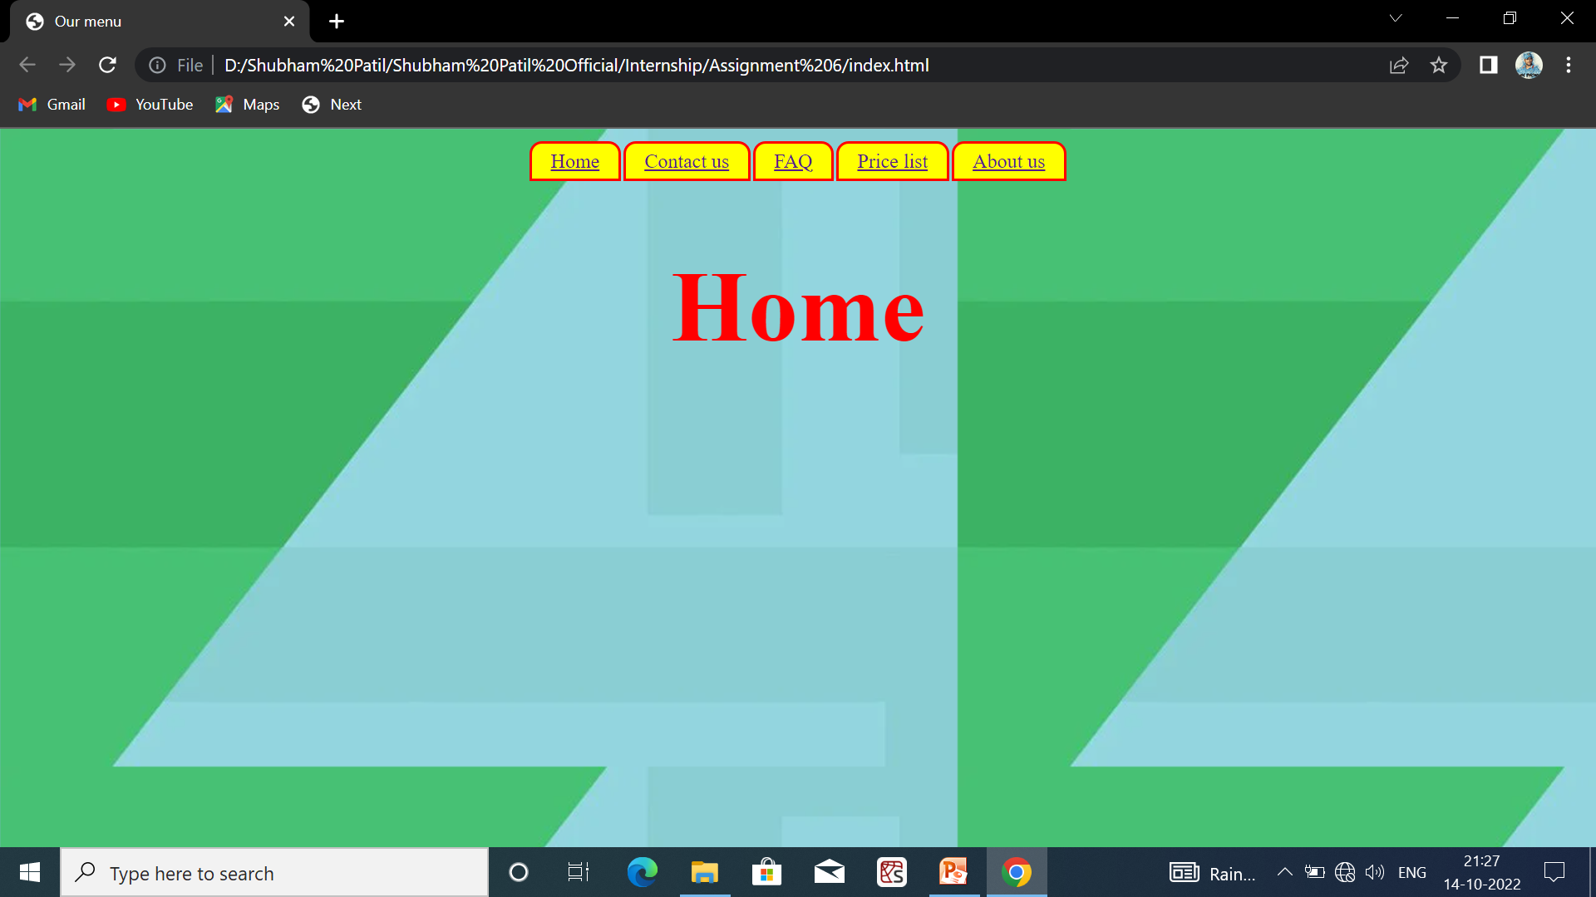
Graphical User Interface
Home

Slide 17
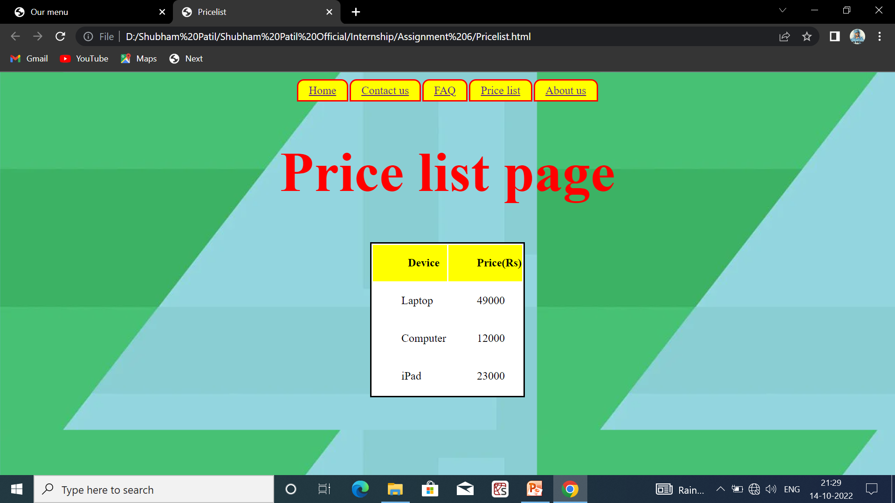
Price List Page

Slide 18
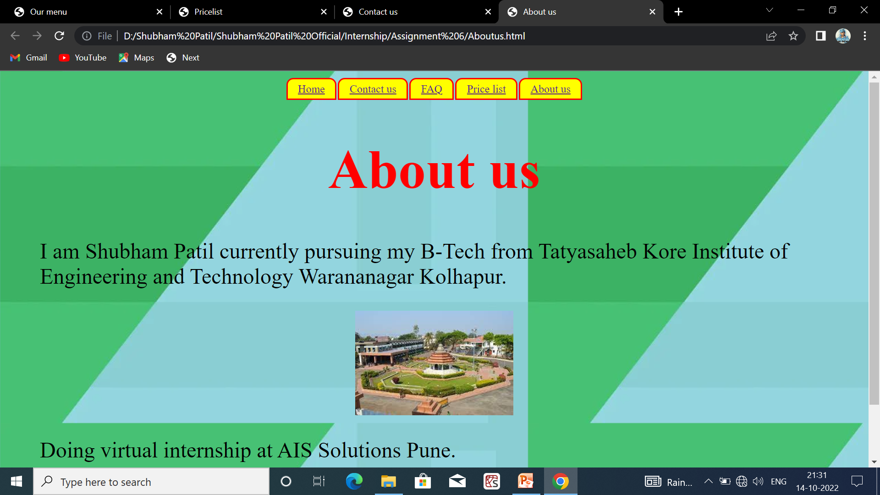
About Us Page

Slide 19
Conclusion
During the internship I have learned about frontend web development and how the actually we can design the website as industry level. Also learned about the technologies (HTML,CSS, JavaScript, Bootstrap) which is used to Design the websites.
I learned to live in a different environment from the one I am used to. Indeed, I grew more independent in work and also in everyday life. I realized that I could do more things than I thought, like learning new things by myself.

Slide 20
Bibliographies :
https://www.w3schools.com
https://www.wikipidea.com
https://www.w3.org/standards/semanticweb/
https://developer.mozilla.org/en/docs
https://sioc-project.org/ontology
https://janastu.org

Slide 21
Thank You

